Slide 1
An Overview of Local Authorities in Alma
Yoel Kortick
Senior Librarian
Sept. 2025

Slide 2
Agenda
Introduction
Why would we use local authorities?
Example One - New authority record created from scratch
Example Two a - Copy from CZ and add non-preferred term
Example Two b - Copy from CZ and add non-preferred term
Example Three - Copy similar from CZ and change as needed
Searching for local authorities

Slide 3
Introduction

Slide 4
Introduction
This presentation will assume that local authorities have already been defined in the institution.
This is a process which is typically done during the implementation phase, though it can also be done at a later stage.
Regarding adding a new local authority vocabulary to Alma, see Adding a Local Authority Definition .
If an institution adds a local authority vocabulary for the first time after implementation, the institution should contact Ex Libris support. This is because an additional “behind the scenes” parameter will need to be defined by Ex Libris in order for local vocabularies to be used. This parameter needs to be defined by Ex Libris and not by the institution.

Slide 5
Introduction
In this presentation the institution has defined that Library of Congress Names (LCNAMES) and Library of Congress Subjects (LCSH) are defined as local authorities (among others).
Each institution can see which authority vocabularies are “Managed Locally” (which means that they can be used as local authorities) at ‘Configuration > Resources > Cataloging > Metadata Configuration > scroll down to section “Authority Vocabularies”’.
When a vocabulary is “Managed Locally” it is also managed globally via the Community Zone.
This is the “Managed Locally” column

Slide 6
Introduction
As we will soon see, the fact that an institution uses local authorities does not mean that the institution uses only local authorities.
It is a combination of local authorities and global authorities (from the Community Zone).

Slide 7
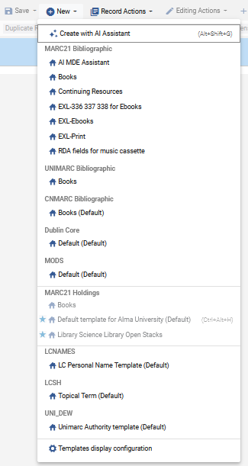
Introduction
If your institution is defined to use local authorities, you will see an option to create a local authority record in the metadata editor. For example:
This institution can create new LCNAMES records and new LCSH records.
If local authorities is defined and the option here to create the local authorities does not appear then it is likely because the default templates for those authorities are not defined to appear. See “Templates Display Configuration” at Working with Record Templates in order to make the templates for local authorities appear.

Slide 8
Why would we use local authorities?

Slide 9
Why would we use local authorities?
Local authorities may be used if
None of the many authority vocabularies in the Community Zone meet the needs of the institution.
An authority vocabulary of the Community Zone does meet the needs of the institution but there are some cases where
  The institution wishes to change a particular authority heading because they do not like the way it appears or think that an end user will find records more successfully with a different preferred or non-preferred term heading.
  The institution wants to use a heading which does not exist in the specific authority vocabulary of the Community Zone.

Slide 10
Why would we use local authorities?
When local authority records are used the system first checks the local authorities and if there is a match then the local authority record is used.
If there is no match in the local authorities, then the system will check the global authority records.
Therefore, local authority records can be used to “override” the global authority record

Slide 11
Example One - New authority record created from scratch

Slide 12
Example One - New authority record created from scratch
The institution uses Library of Congress Subject Headings (LCSH) and wants to use subject “Gefilte Fish”.
The cataloger discovers that there is no LCSH for “Gefilte Fish”.
The cataloger therefore decides to create a local authority record for LCSH with heading “Gefilte Fish”.

Slide 13
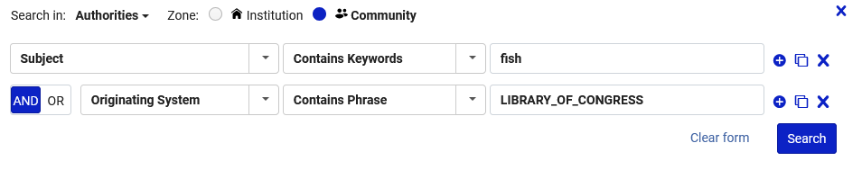
Example One - New authority record created from scratch
If we search the Community Zone for Authorities with the following search …
where (Subject contains keywords "fish" AND Originating System contains phrase "LIBRARY_OF_CONGRESS")

Slide 14
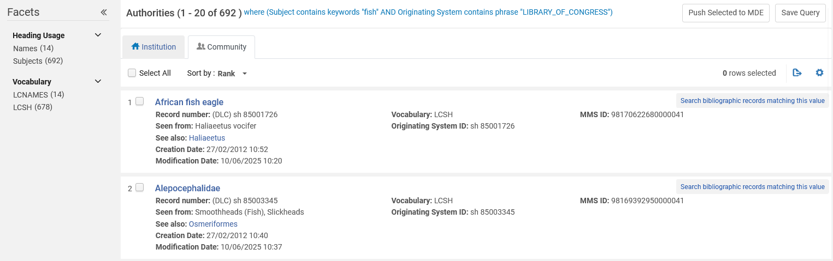
Example One - New authority record created from scratch
Then we will see that there are headings for LCSH with the word “fish”

Slide 15
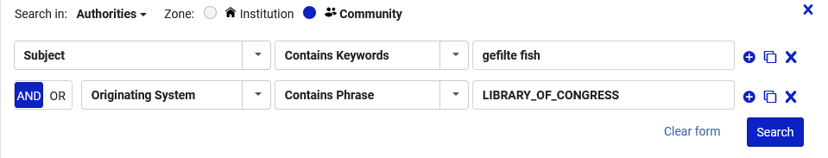
Example One - New authority record created from scratch
However, if we search the Community Zone for Authorities with the following search …
where (Subject contains keywords “gefilte fish" AND Originating System contains phrase "LIBRARY_OF_CONGRESS")

Slide 16
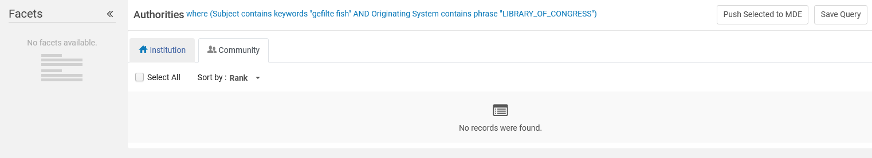
Example One - New authority record created from scratch
Then we see that there are no headings for LCSH with the word “gefilte fish”

Slide 17
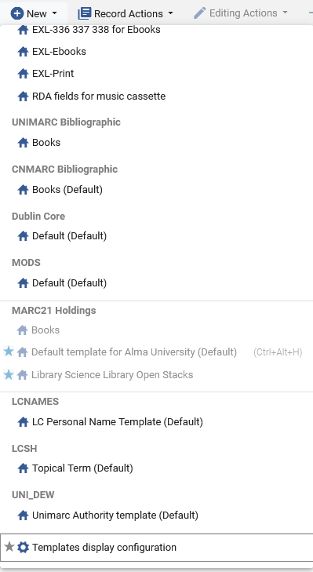
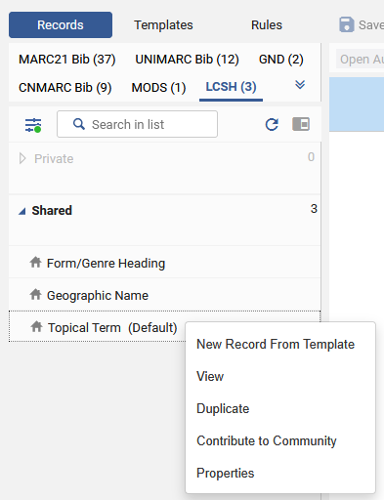
Example One - New authority record created from scratch
Now that we have confirmed that the heading does not exist in the global authority for LCSH, we will create a local LCSH authority record in the metadata editor
Option 1 from the “New” menu
Option 2 directly from a template

Slide 18
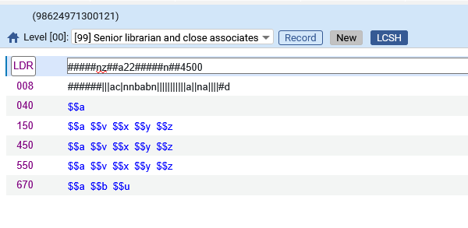
Example One - New authority record created from scratch
This is what we get when creating a new authority record from the template “Topical Term” either via the “New” menu or directly from the template

Slide 19
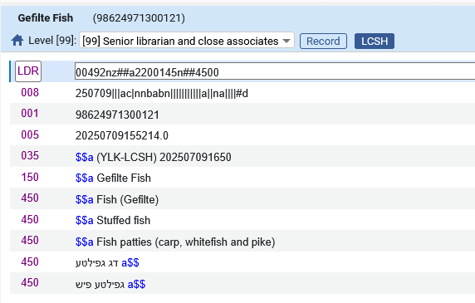
Example One - New authority record created from scratch
Here is our local LCSH authority record after completing the cataloging and saving

Slide 20
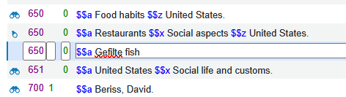
Example One - New authority record created from scratch
In a bibliographic record with title “The restaurants book : ethnographies of where we eat” we use the heading and then do F3. In the 650 field the 2nd indicator is “0” and therefore LCSH will be used.

Slide 21
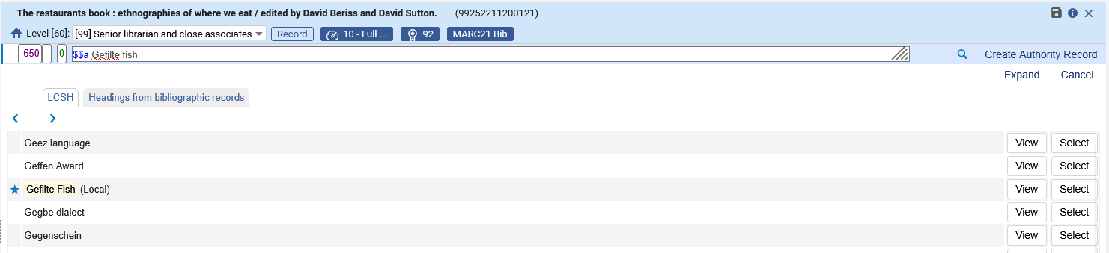
Example One - New authority record created from scratch
We see the authority heading with an indication that it is local, and we select it
Alma knew to bring LCSH headings because the 650 2nd indicator is 0
We have an indication that this is a “local” authority record

Slide 22
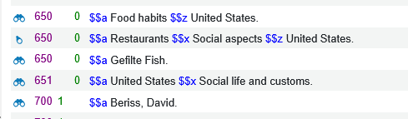
Example One - New authority record created from scratch
The subject heading is linked to the local authority record
We will click the binoculars just to see that it really is linked to the local authority record

Slide 23
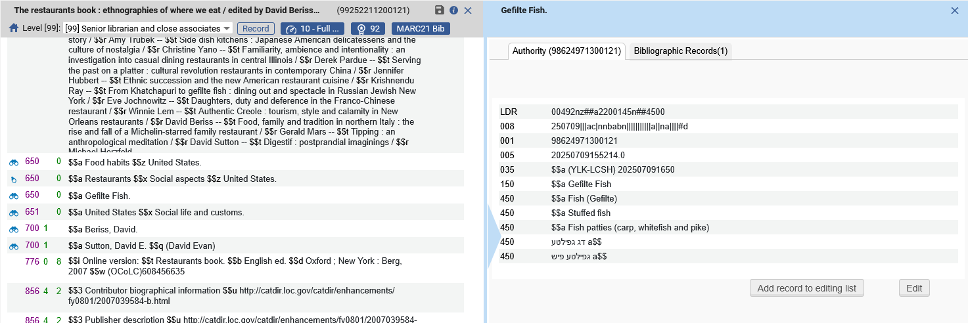
Example One - New authority record created from scratch
After clicking the binoculars, we see that it really is linked to the local authority record
This is the System Control Number we gave to the local authority record. Therefore, we know that this is the local authority record

Slide 24
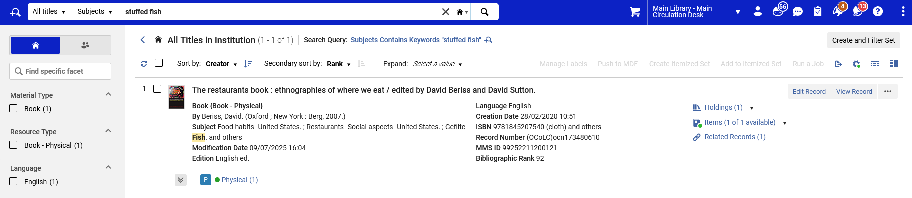
Example One - New authority record created from scratch
The record may be retrieved in Alma by a non preferred term of the local authority record

Slide 25
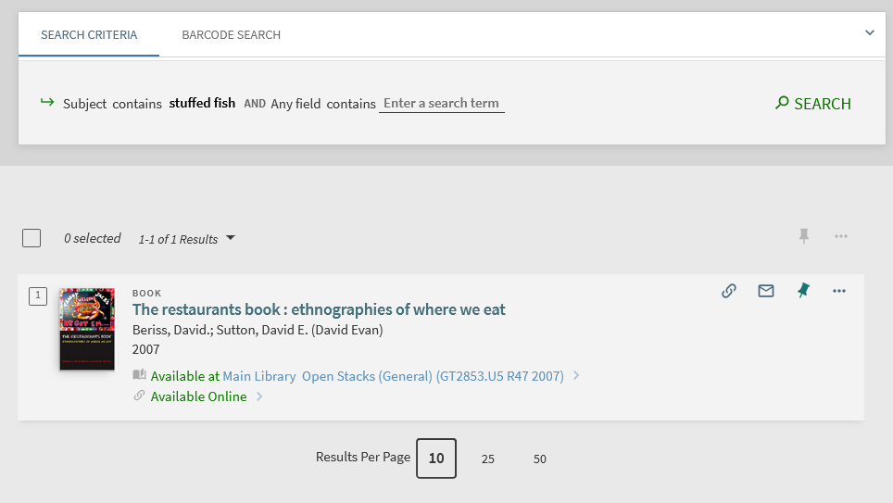
Example One - New authority record created from scratch
The record may also be retrieved in discovery by a non preferred term of the local authority record

Slide 26
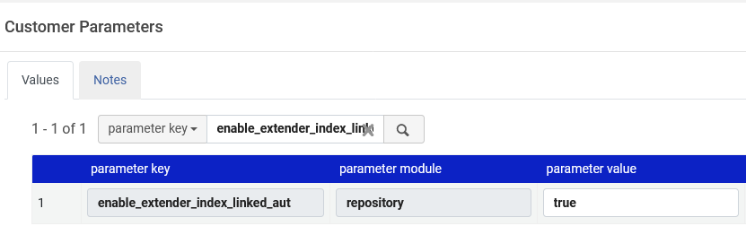
Example One - New authority record created from scratch
While this is not specifically related to local authority records, note that the record was found via the non preferred term of the authority record because in Alma we have defined “true” for parameter enable_extender_index_linked_aut at “Configuration > Resources > General > Other Settings”.
This parameter is also explained at Configuring Other Settings (Resource Management)

Slide 27
Example Two a - Copy from CZ and add non-preferred term

Slide 28
Example Two a - Copy from CZ and add non-preferred term
The institution uses Library of Congress Subject Headings (LCSH) and wants to have an additional “non-preferred term” for LCSH heading “Information technology”
LCSH heading “Information technology” exists in LCSH authority record Library of Congress Control Number “sh 87002293”
The institution wants to add non-preferred terms “IT specialists” and “Information technology specialists”

Slide 29
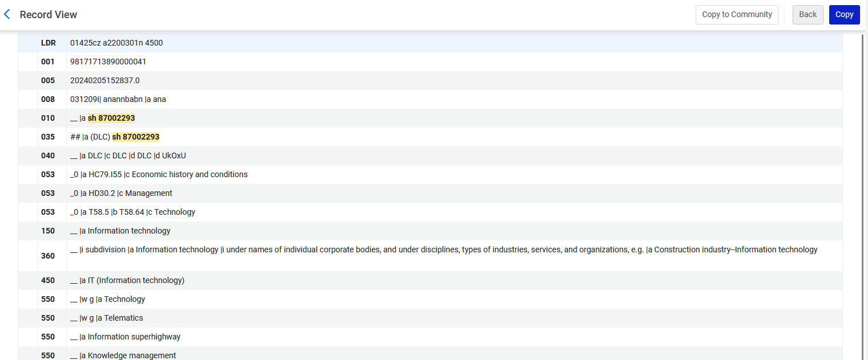
Example Two a - Copy from CZ and add non-preferred term
This is the LCSH authority record in the Community Zone
We will copy this record to our institution
There currently is no non-preferred term (seen from) or see also term for “IT specialists” or “Information technology specialists” in the CZ

Slide 30
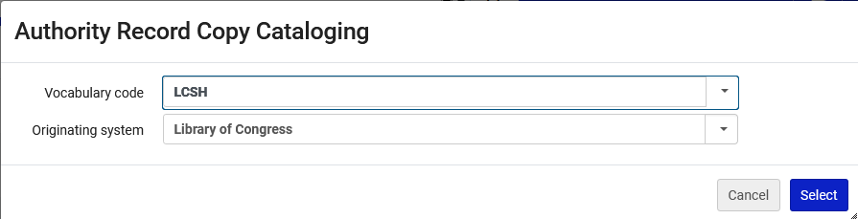
Example Two a - Copy from CZ and add non-preferred term
After clicking “Copy” we will leave the default values for the vocabulary code and the originating system and click “Select”.

Slide 31
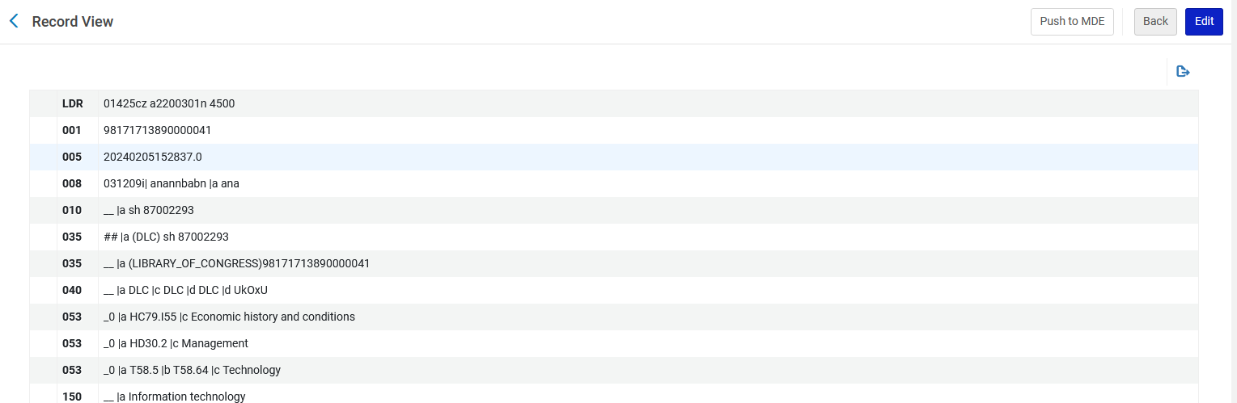

Example Two a - Copy from CZ and add non-preferred term
A new local authority record is created in the institution, and we edit it
We will edit the record in our institution

Slide 32
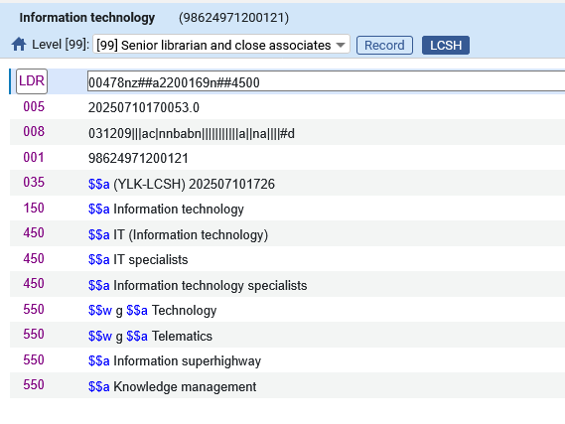
Example Two a - Copy from CZ and add non-preferred term
We have edited the record in our institution
We have also removed other fields and added our own 035 field
We will leave the preferred term “Information technology”
These are our new non-preferred terms

Slide 33
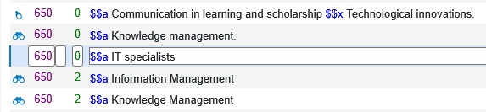
Example Two a - Copy from CZ and add non-preferred term
We will now save bibliographic record with title “Advanced methodologies and technologies in library science, information management, and scholarly inquiry” which has the non-preferred term “IT specialists” from the local authority record.
We are not doing “Open Authority Headings” (F3) to look for a heading, we are just saving the record
This is a 650 field with 2nd indicator 0 so it should try to match on LCSH authority records

Slide 34
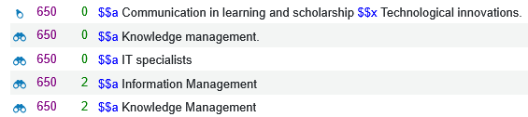
Example Two a - Copy from CZ and add non-preferred term
The bibliographic heading links to an authority record and we will click the binoculars

Slide 35
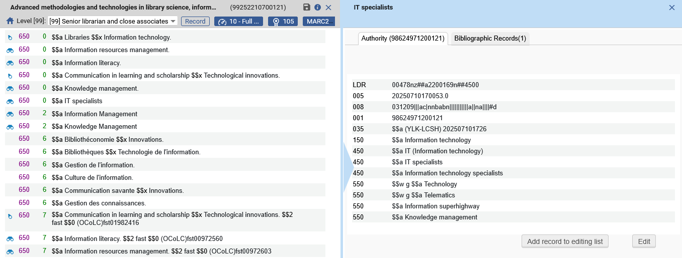
Example Two a - Copy from CZ and add non-preferred term
We see that it has linked to the local authority record

Slide 36
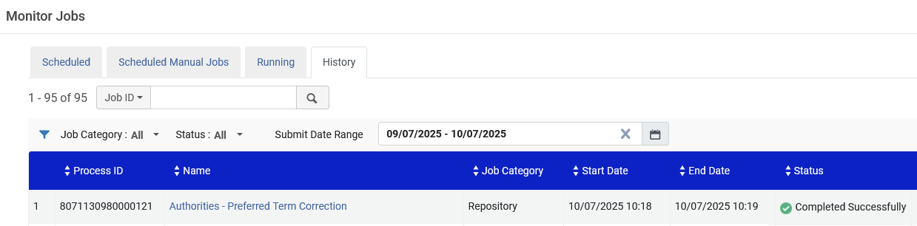
Example Two a - Copy from CZ and add non-preferred term
The regularly scheduled job “Authorities – Preferred Term Correction” runs

Slide 37
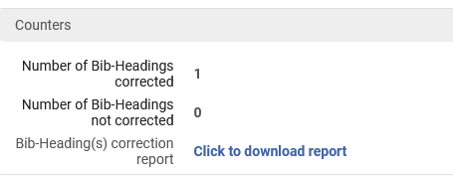
Example Two a - Copy from CZ and add non-preferred term
In the job report for “Authorities – Preferred Term Correction” we see that the heading was updated

Slide 38
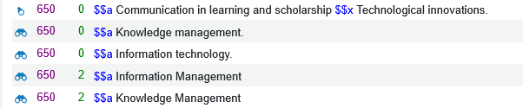
Example Two a - Copy from CZ and add non-preferred term
The bibliographic record was updated from non preferred term “IT specialists” to preferred term “Information technology”

Slide 39
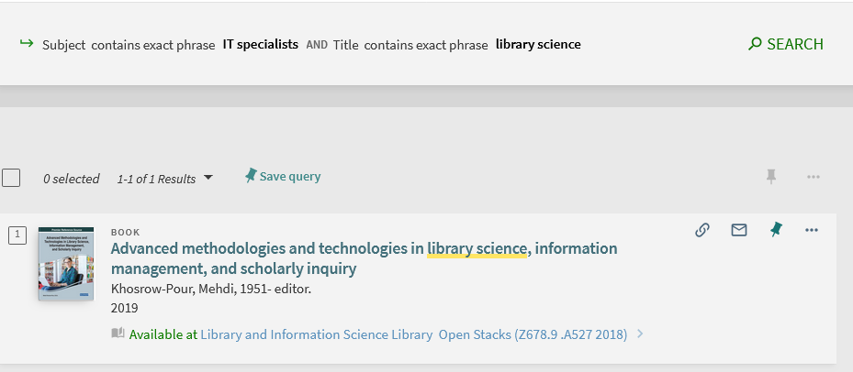
Example Two a - Copy from CZ and add non-preferred term
If we search discovery for the non preferred term we find the record

Slide 40
Example Two b - Copy from CZ and add non-preferred term

Slide 41
Example Two b - Copy from CZ and add non-preferred term
The institution uses Library of Congress Names (LCNAMES) and wants to have an additional “non-preferred term” for LCNAMES heading “Uniwersytet Jagielloński. Instytut Historii.”
LCNAMES heading “Uniwersytet Jagielloński. Instytut Historii.” exists in LCNAMES authority record Library of Congress Control Number “n 80092221”
The institution wants to add non-preferred term “Jagiellonian University. Institute of History.”
By doing so the institution is allowing for users to be able to find the record by searching for “Jagiellonian University. Institute of History.”

Slide 42
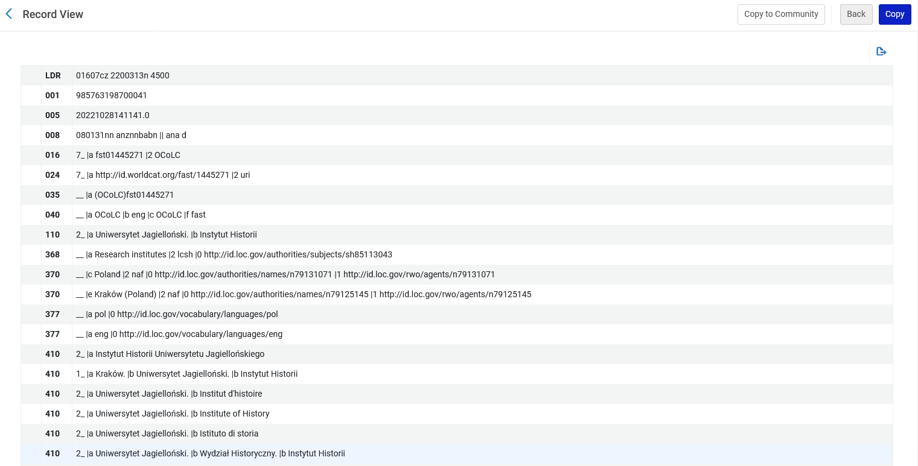
Example Two b - Copy from CZ and add non-preferred term
This is the LCNAMES authority record in the Community Zone
We will copy this record to our institution
There currently is no non-preferred term (seen from) or see also term for “Jagiellonian University. Institute of History.” in the CZ

Slide 43

Example Two b - Copy from CZ and add non-preferred term
After clicking “Copy” we will choose Vocabulary code LCNAMES and Originating system “Library of Congress” and click “Select”.

Slide 44
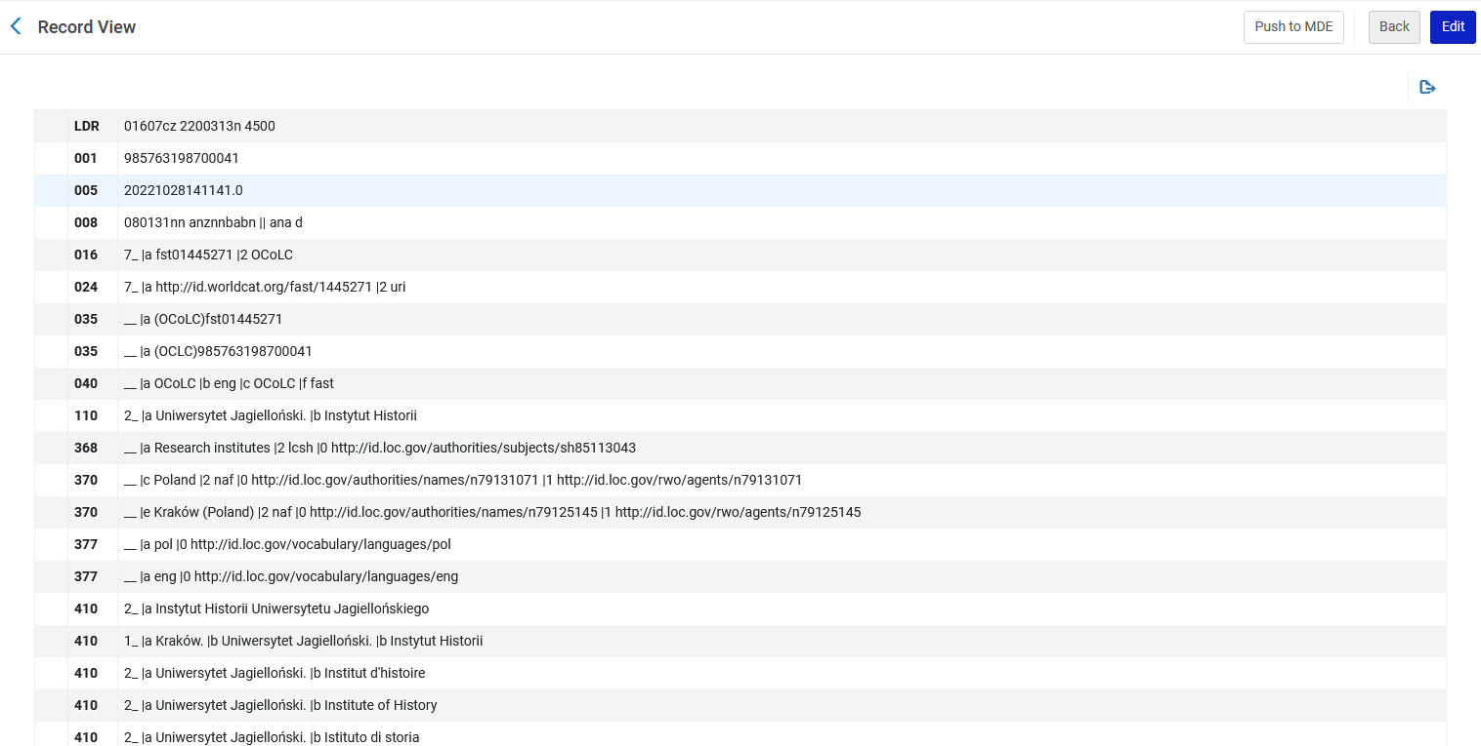
Example Two b - Copy from CZ and add non-preferred term
A new local authority record is created in the institution, and we edit it
We will edit the record in our institution

Slide 45
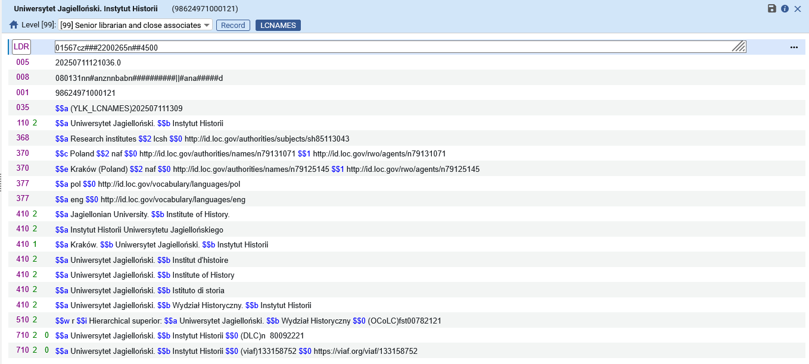
Example Two b - Copy from CZ and add non-preferred term
We have edited the record in our institution
We have also removed other fields and added our own 035 field
We will leave the preferred term “Uniwersytet Jagielloński. Instytut Historii”
These is our new non-preferred term

Slide 46
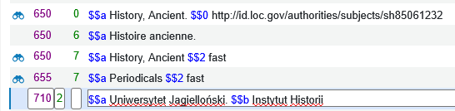
Example Two b - Copy from CZ and add non-preferred term
We will now save bibliographic record with title “Electrum : studia z historii starożytnej / Uniwersytet Jagielloński, Instytut Historii.” which has the preferred term “Uniwersytet Jagielloński. Instytut Historii” from the local authority record.
We are not doing “Open Authority Headings” (F3) to look for a heading, we are just saving the record
This is a 710 field and Alma should try to match on LCNAMES authority records because the institution uses LCNAMES

Slide 47
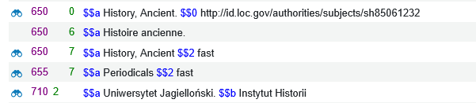
Example Two b - Copy from CZ and add non-preferred term
The bibliographic heading is saved, and the heading has linked to an authority record.
We will click the binoculars

Slide 48
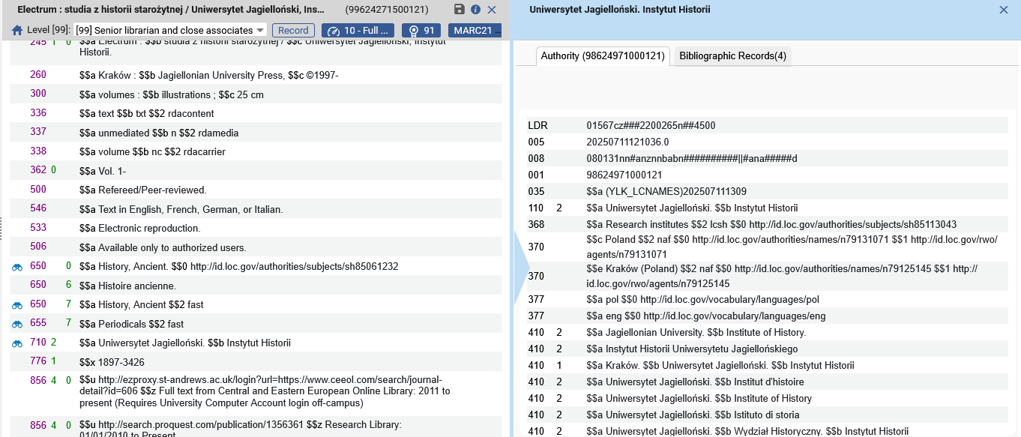
Example Two b - Copy from CZ and add non-preferred term
We see that it has linked to the local authority record

Slide 49
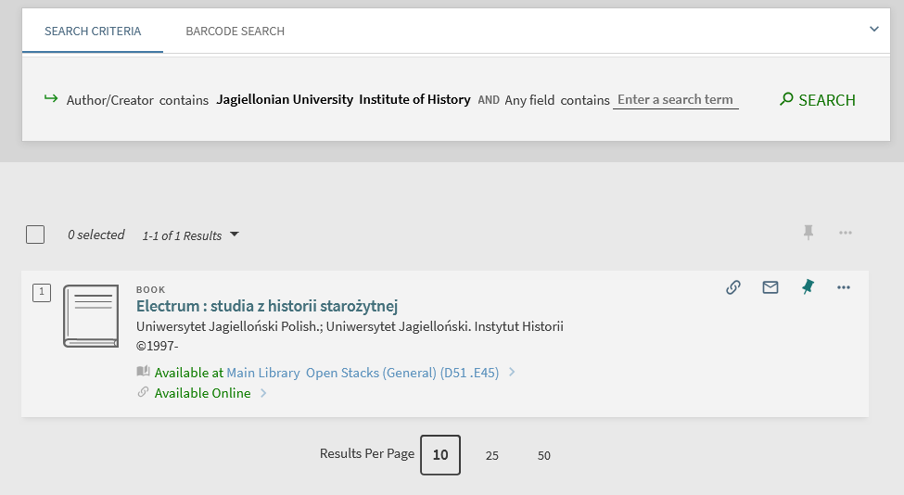
Example Two b - Copy from CZ and add non-preferred term
If we search discovery for the non preferred term, we find the record

Slide 50
Example Three - Copy similar from CZ and change as needed

Slide 51
Example Three - Copy similar from CZ and change as needed
The institution has a publication for which they want to add a subject “Libraries Krakow”.
The cataloger checks the LCSH authorities in the Community Zone and sees that this subject does not exist.
The cataloger copies a similar record and changes it to be “Libraries Krakow”.
  Instead of creating a new record we have decided to copy a similar record and then change it.
The cataloger also adds a non preferred term “Libraries Cracow”.
  This way the end user will be able to search for either:
  “Libraries Krakow”
  “Libraries Cracow”

Slide 52
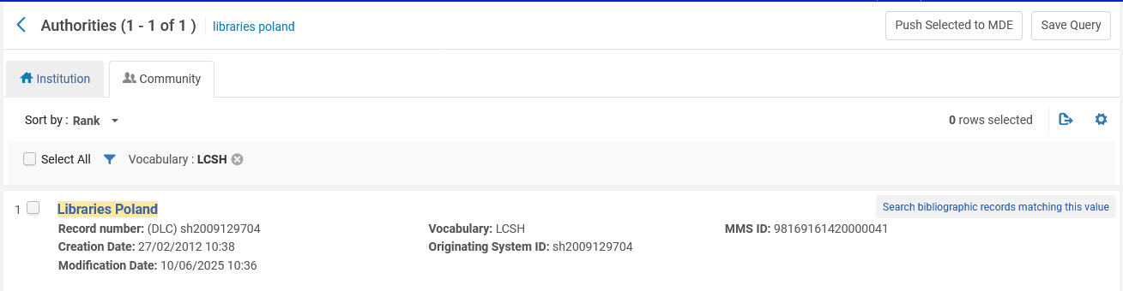
Example Three - Copy similar from CZ and change as needed
This is a similar record in the Community Zone. We will click the title to view it and then click “Copy”

Slide 53
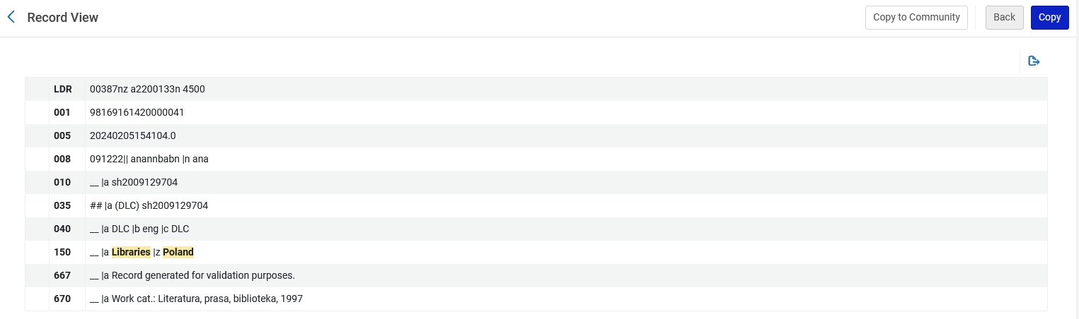
Example Three - Copy similar from CZ and change as needed
Click “Copy”

Slide 54
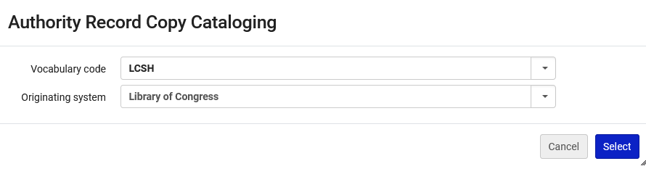
Example Three - Copy similar from CZ and change as needed
We will keep the defaults

Slide 55
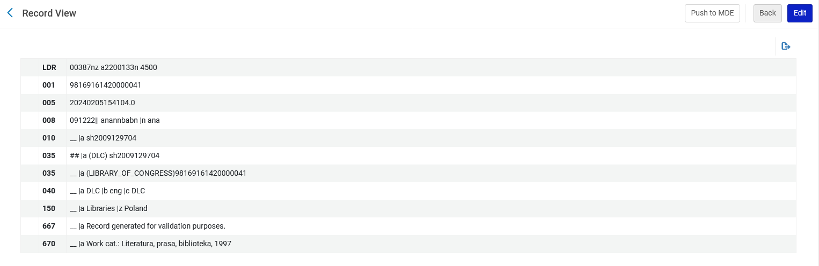

Example Three - Copy similar from CZ and change as needed
The new record is created in the institution, and we will edit it

Slide 56
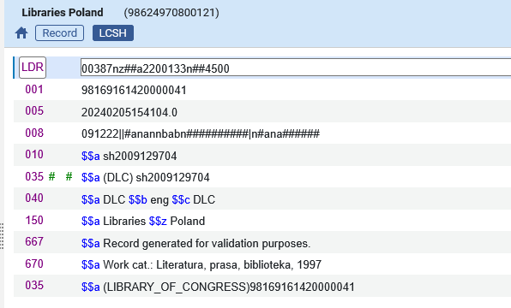
Example Three - Copy similar from CZ and change as needed
Here is the new record we copied

Slide 57
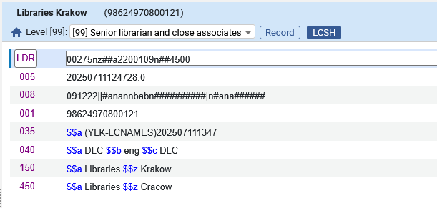
Example Three - Copy similar from CZ and change as needed
And here it is after changing it to our own needs

Slide 58
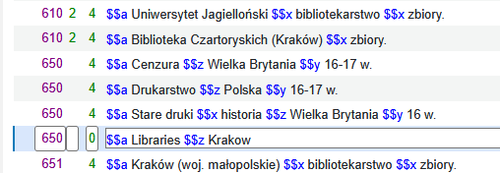
Example Three - Copy similar from CZ and change as needed
Now we use this new heading in bibliographic record title “Sixteenth-century rare books on and by English recusants in the libraries of Kraków”.
We have not yet saved the record.

Slide 59
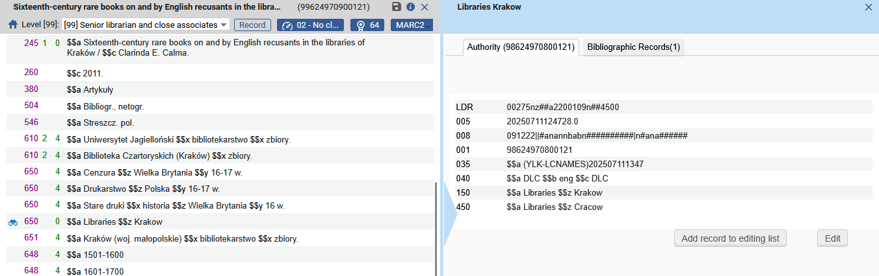
Example Three - Copy similar from CZ and change as needed
After saving the record, the heading links to the authority record which we created

Slide 60
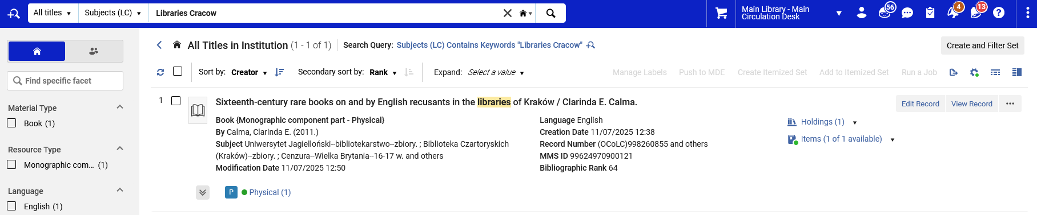
Example Three - Copy similar from CZ and change as needed
And the non-preferred term can be used to find the record in Alma (“Libraries Krakow” is catalogued in the record and we can find it via “Libraries Cracow”)

Slide 61
Searching for local authorities

Slide 62
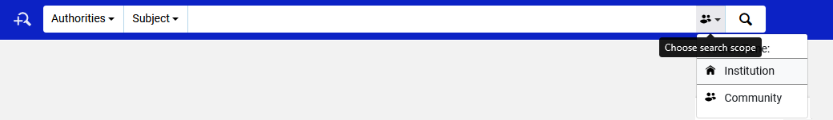
Searching for local authorities
The institution can find all of their local authorities by searching for authorities in the institution

Slide 63
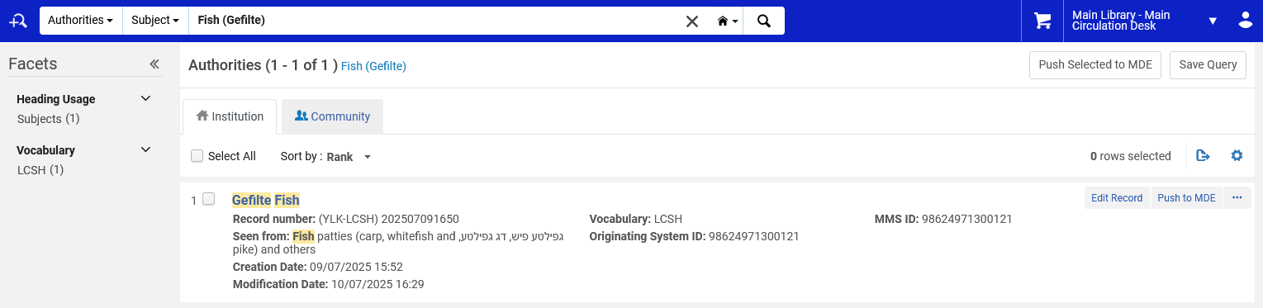
Searching for local authorities
Example “One” make in this session

Slide 64
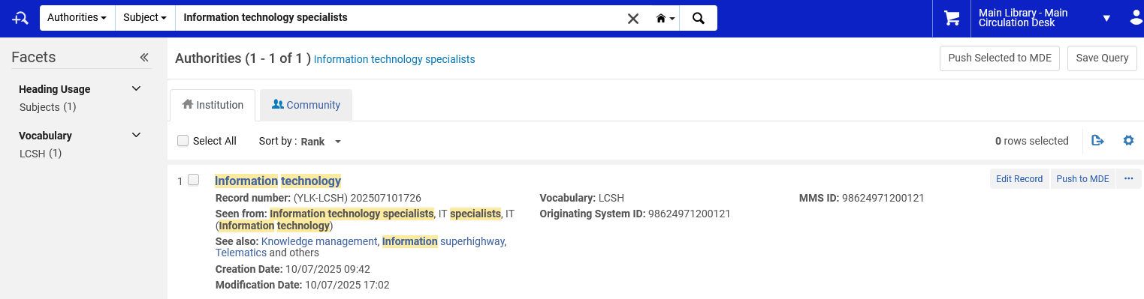
Searching for local authorities
Example “Two a” made in this session

Slide 65
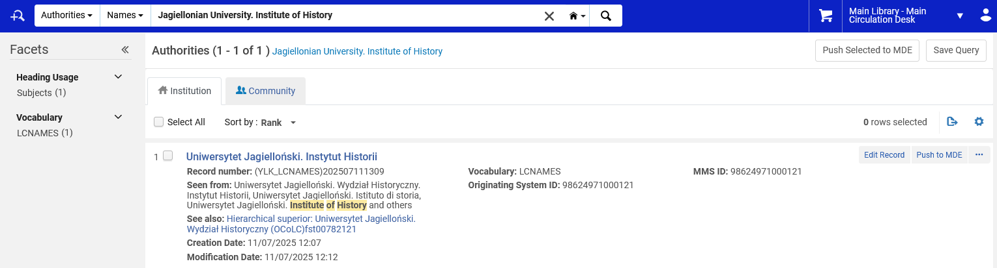
Searching for local authorities
Example “Two b” made in this session

Slide 66
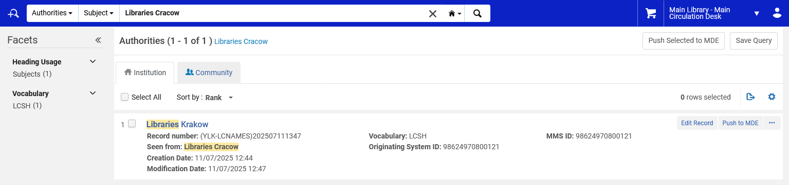
Searching for local authorities
Example “Three” made in this session

